Slide 1
Philanthropic Support for U.S. Fusion Engagement
A Critical Component of Global Energy Strategy and U.S. Technology Leadership

Slide 2
The New Stellar Energy
Foundation
A critical climate change partnership With a joint mission:
Fusion Energy
Soon Enough to Make a Difference

Slide 3
Stellar Energy Foundation, Inc.
Founders
Jesse I. Treu, Ph.D.
Partner and co-founder, Domain Associates, L.L.C.
33 years of professional venture capital experience
Matthew D. Miller, Ph.D.
Seasoned C-level technology executive
Serial technology entrepreneur

Slide 4
Energy for the Common Good, Inc.
Founders
Wallace Johnston
President and co-founder, 2013
30 years of professional finance and tech initiation experience
Jane Hotchkiss
Strategy Consultant and co-founder
30 years of renewable and clean energy: policy to projects

Slide 5
new people slide(s) to list all five of us; probably replaces previous slide)

Slide 6
Visionaries and Advisors
Rein Beeuwkes Peter Burnim
Dennis Whyte Steven Cowley
(Bill Gates) (Simons Foundation)

Slide 7
Fusion’s Climate Change Commitement
Renewable and clean energy’s missing partner
Needs technology to store CO₂ for centuries
Geological sites for store not uniformly available

Slide 8
“Green Energy” Ideas Fall Short
Fossil fuel plus CO₂ sequestration
Needs technology to store CO₂ for centuries
Geological sites for store not uniformly available

Slide 9
“Green Energy” Ideas Fall Short
Solar/wind plus storage
Generating sites not uniformly available
Need to develop inexpensive energy storage technology

Slide 10
“Green Energy” Ideas Fall Short
Nuclear power (fission)
Long term radioactive waste concerns
Catastrophic failure of nuclear facility is a risk
Weapons potential of fuel

Slide 11
Fusion Energy
Fusion Energy has genuine potential as a clean, inexpensive source of power on the scale needed to support a global economy.

Slide 12
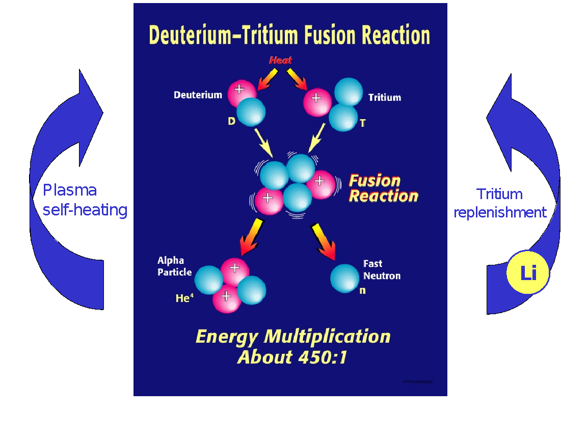

Slide 13
Fusion Energy
Safe
Fuel is available
No long term environmental affects
Can be sited anywhere
Generates no CO₂ or other greenhouse gases

Slide 14
What’s Needed?
Holding a stable “plasma” of D and T…
- At high temperature (~170 million ºC)
- High enough pressure
- For long enough to generate power (avoid unstable turbulence)
How to surround the plasma with a material
- Damage to the walls ?
How to transfer the heat out ?

Slide 15
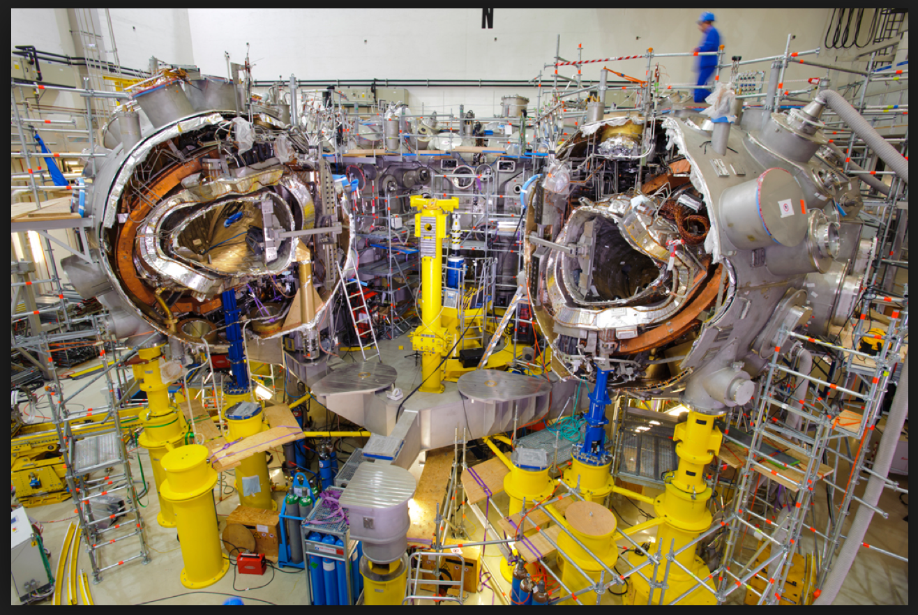

Slide 16
How to Hold the Plasma
Gravity – this is how stars manage it
Inertial method
- Compress a sphere of “ingredients” with lasers
- Under development at Lawrence Livermore National Lab (LLNL) and elsewhere
- Status: awaiting demonstration of ignition at LLNL; further to go than magnetic confinement
Magnetic confinement
- Use magnetic fields to contain the plasma
Need to get the details right for stability
Need to develop solutions for the surrounding materials

Slide 17
Magnetic Designs
Tokomak
Torus shape
Inherent instabilities – can damage the vessel
Need injection of power to sustain the burn
ITER (International project in France) under construction
Stellarator
Twisted torus
Inherently stable plasma
Does not require “injections” of power
Requires modern computer power to design
PPPL Stellarator canceled in 2008 due to cost over-runs

Slide 18
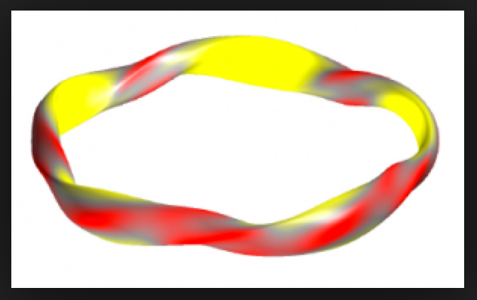

Slide 19
<< slide on current state of R&D with a message of “we are getting closer to reality”; maybe list next important R&D steps?>>>

Slide 20
slide of what we need to do now and why
Infrastructure
Regulatory
Advocacy
Education
…..

Slide 21
Wall Design
ITER – not designed to solve the wall or heat transfer issues, but will add important knowledge.
“Liquid Metal” technology
- Promising idea for a survivable wall
- Needs to be tried out
- Paves the way for heat transfer

Slide 22
Maybe insert a slide or two on details of the advocacy, education, etc. activities that are needed

Slide 23
Fusion R&D Status
U.S. government funding has been far too little.
Arguably the most promising pathway to commercial power generating fusion (Stellarator) mostly cut off in the U.S. due to over-runs in 2008.
<<< mention General Fusion ? Others ?? >>>
International project (ITER) employs an earlier tokamak design which is a good vehicle for studying burning plasmas, but not the best ultimate reactor.<<< comment on time frame? >>>
German W-7X Stellarator went on line this year and will produce important results on one specific design concept.<<<update!>>>

Slide 24
What’s Needed
Next-Generation Stellarator is possible
Incorporate modern computer capabilities to fine-tune the shape
Test more compact stellarator design
- Solve residual turbulence issues
- Needs to be designed and built
- <<< manaufacturability study >>>
Try out Liquid Metal Wall technologies

Slide 25
Princeton Plasma Physics Lab “PPPL”
<<< need to update this>>>
Department of Energy National Laboratory.
A pioneer in magnetically confined controlled fusion research.
Pioneered a Stellarator design in the 2000’s.
Stellarator was canceled by DOE at the beginning of the financial crisis, due to cost-over-runs.
Currently operate a major tokamak and other smaller experiments.
Team still in place, anxious to work on Next-Gen Stellarator and Liquid Metal Walls.

Slide 26
MIT Plasma Science and Fusion Center
Leadership center of excellence in High Transition Temperature Superconducting Magnet technology
This technology offers potential for compact and thus cheaper designs for fusion energy reactors
Offers a clear path to commercially practical electricity generators
<<< need to talk about CFS>>>

Slide 27
Specifically….
$5MM scopes out concepts for a Next-Generation Stellarator design.
$3MM funds testing of Liquid Metal Wall prototypes.
Positions that design for government funding ~$1.5B to build Next-Gen Stellarator possibly with Liquid Metal Walls.

Slide 28
Goals
Fund Next Generation Stellarator Design.
Fund Liquid Metal Wall prototype testing.
Be ready for Government Funding of the next generation of Stellarator
<<<we need to reassess technical talking points/goals>>>

Slide 29
What’s at Stake
Climate modeling suggests global warming will be severe in 50 years.
We need to get serious NOW to avoid catastrophic climate affects.
We need to accelerate solutions to the energy problem now, while there is still (barely) enough time!
Now is the time to fund the Next Gen Stellarator.

Slide 30
Need a wrap up slide to either substitute for or complement the “Goals” slide from back when SEF was solely R&D focused.

Slide 31
Stellar Energy Foundation
Philanthropic Support
For
Next Generation Stellarator

